Slide 1

Marketing strategy for increasing revenue

Slide 2
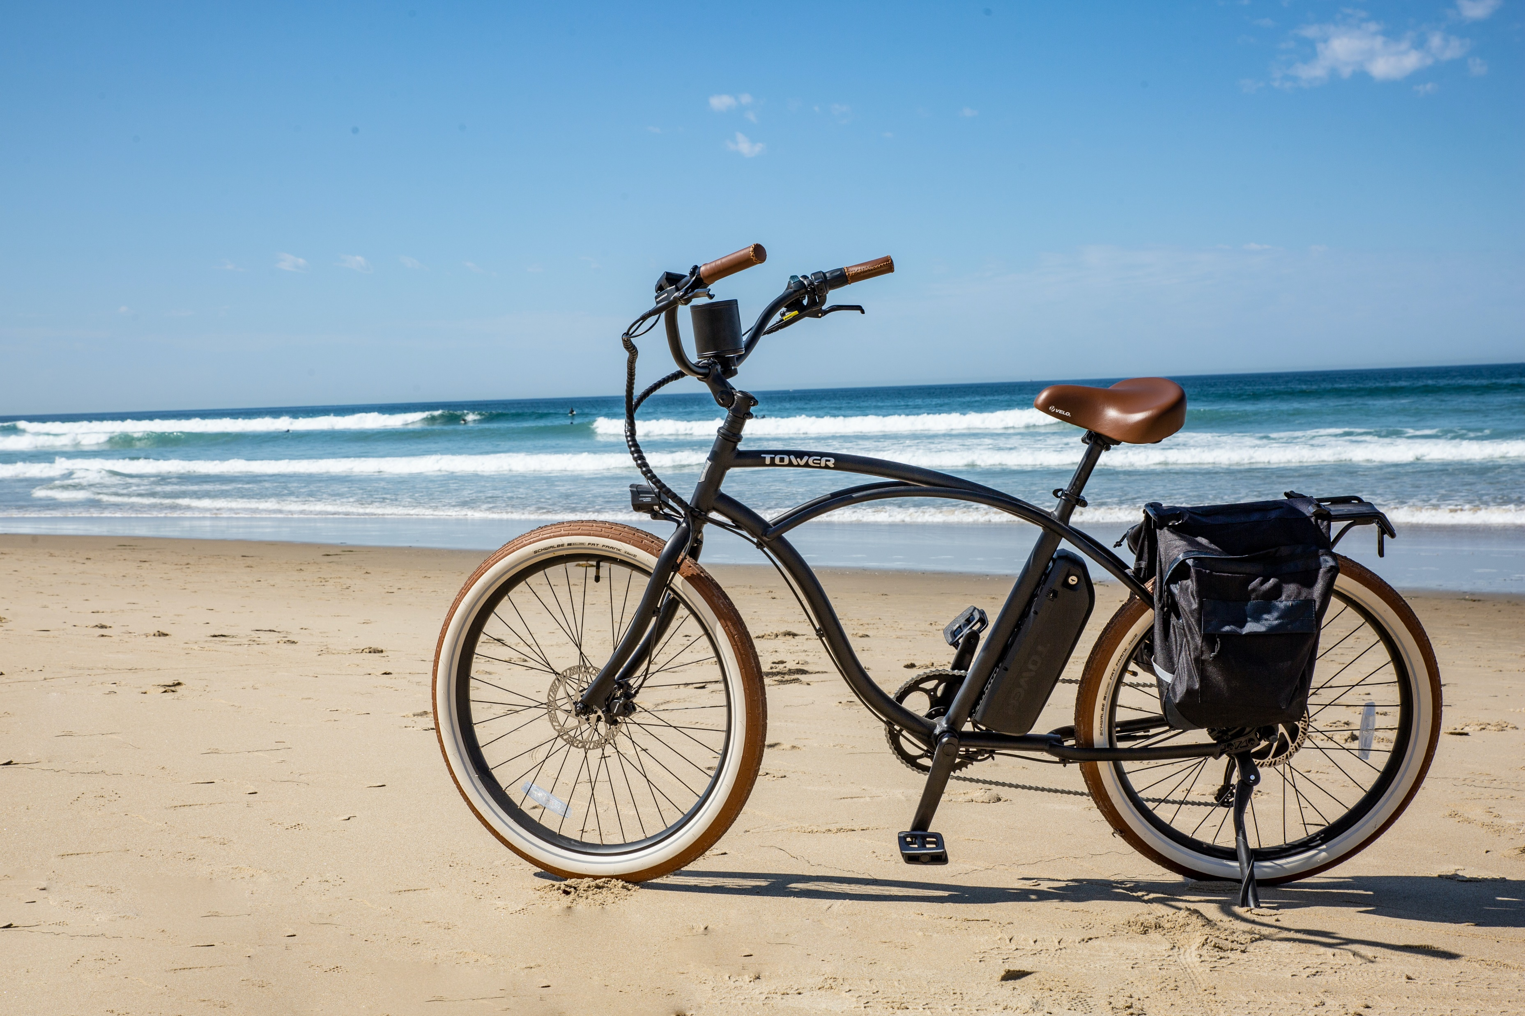
Problem?
Cyclistic Bike-Share needs to convert Casual customers into members because the company will be more profitable if it does.
We need to identify how casual members use Cyclistic services differently from members

Slide 3
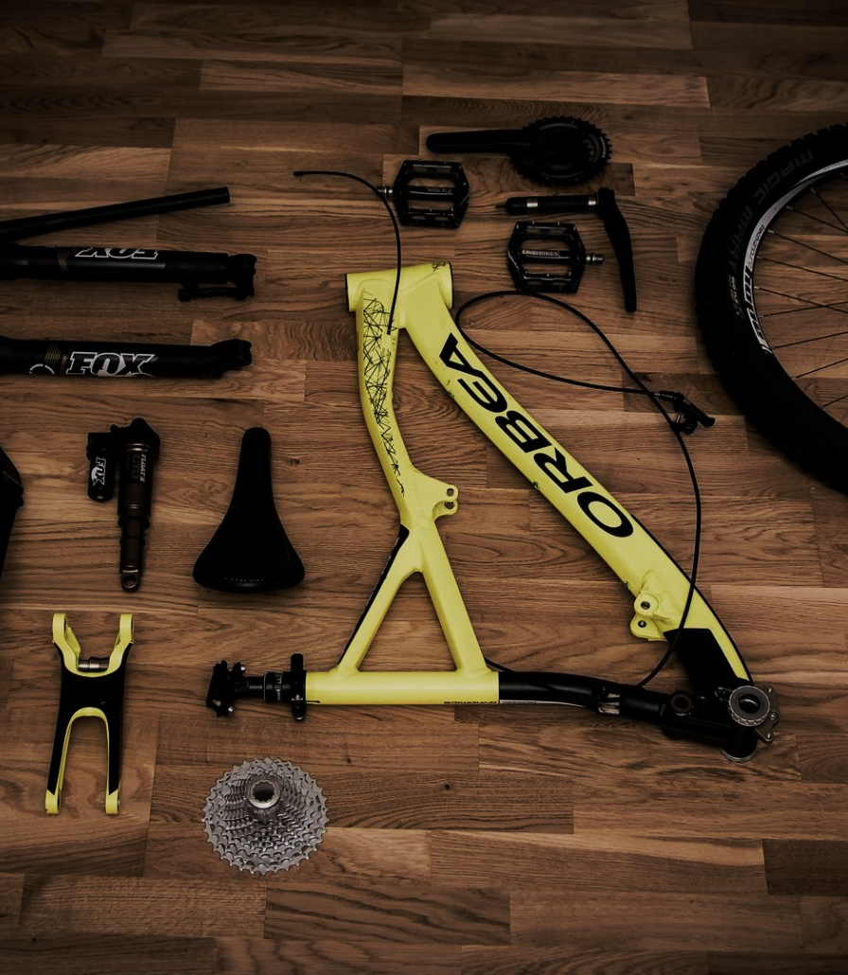
Process
Data Understanding
Data Cleaning
Data Analysis
Uncover insights
Data Visualizations

Slide 4
Data utility for solving the problem
426862 unique trips in the first 3 months of the 2020
3 months’ worth of historical data analyzed using Microsoft Excel, Bigquery, and Tableau.
25 minutes and 30 seconds
average weekly length
Tuesday
Is the most popular day for rides

Slide 5
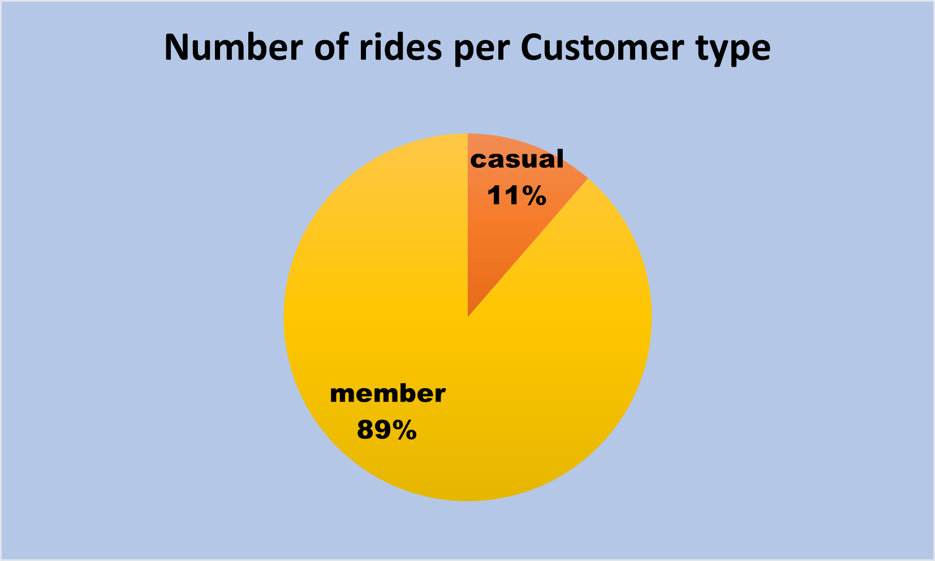
Insights
Casual customers take 11% of the of the rides as opposed to the 89% of the members.

Slide 6
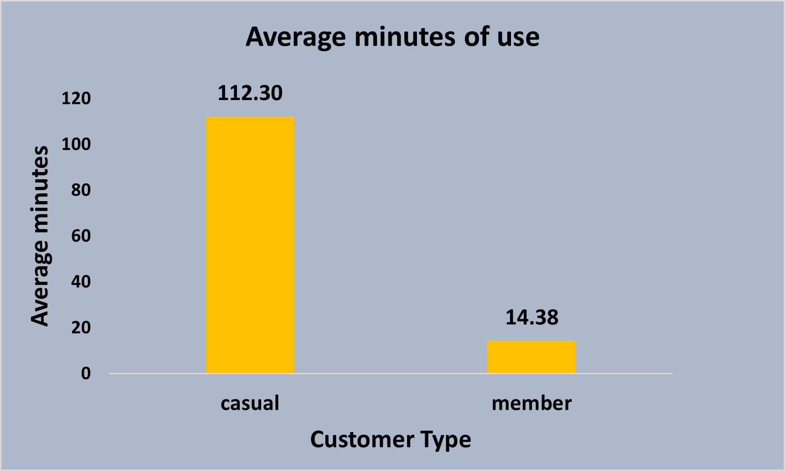
min
Casual customers seem to use the bikes longer than the members on average
min

Slide 7
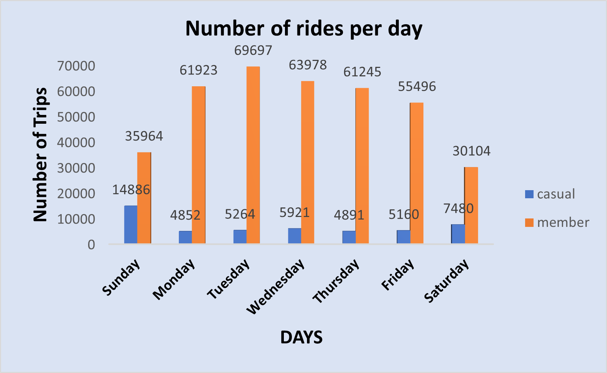
Most rides by casual customers are on weekends, with Sunday being the peak.
Members seem to use the bikes during weekdays consistently. They use bikes the least on the weekends.

Slide 8
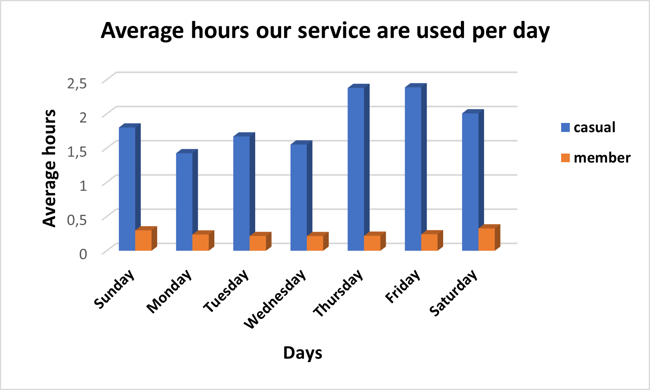
Casual customers use the bikes longer on Thursday, Friday, and Saturday.
Members are consistent with the time they use the bikes.

Slide 9
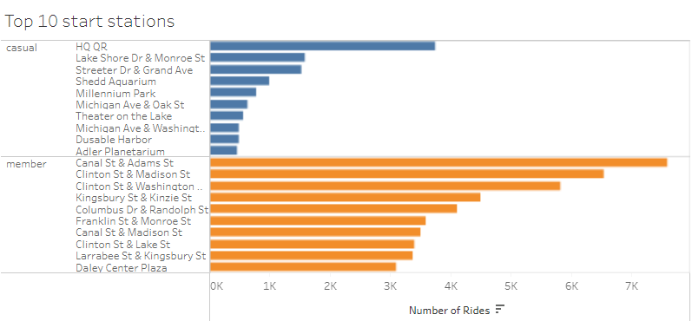
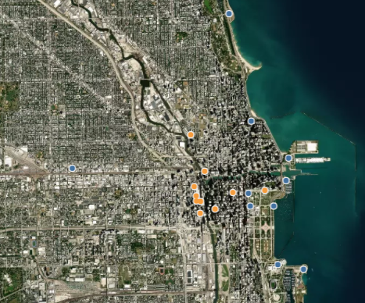
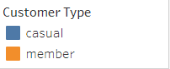
The most used starting stations by members are located in-land.
The most used starting stations by casual customers are located by the water.

Slide 10
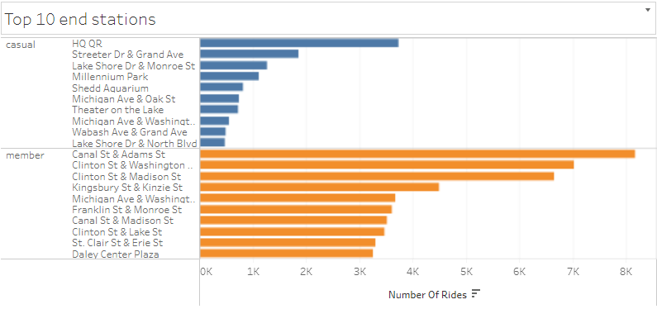
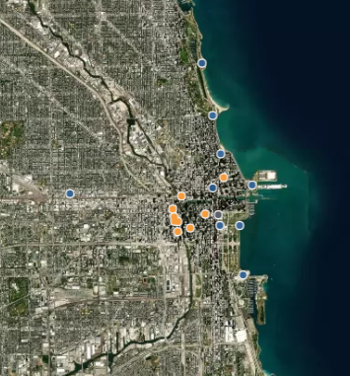
Most used end stations by members are located in-land
Most used end stations by casual customers are located by the Water

Slide 11
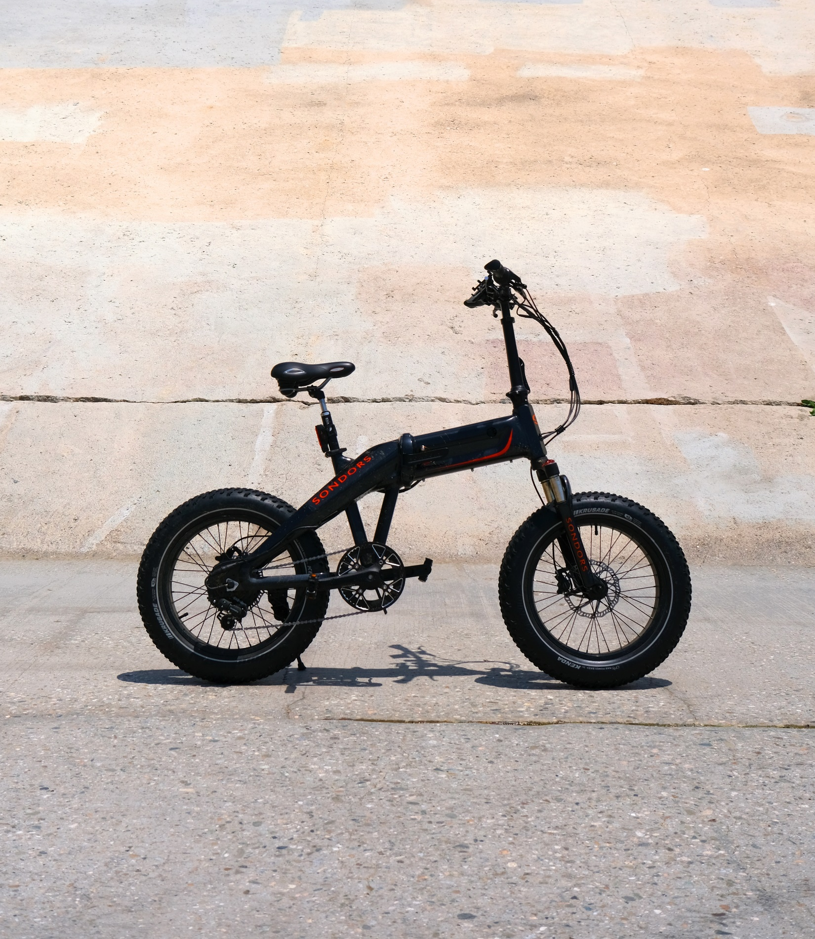
Summary
Casual customers take fewer trips than members but take longer trips on average than members.
Members’ most used start stations and end stations are located inland and have a short distance between them.
Casual customers’ start stations and end stations are located by the waters and have a longer distance between them.

Slide 12

Conclusion
Members use the bikes for short commutes possibly for commuting to schools and work.
Casual customers use the bikes for longer commutes possibly for recreational purposes like friend outings, dates, exercises, etc

Slide 13

Recommendations
Advertise the bikes as a form of entertainment.
Set a time and distance limit for non-members, add charges for exceeded limits
Enable a feature that allows members to reserve bikes

Slide 14

Thank You!
Any Questions?

